Slide 1

Strings, IO, New Methods and API Enhancements

Slide 2









▪

Slide 3

▪
▪

Slide 4

▪
▪
▪

Slide 5

▪
▪
▪
▪

Slide 6

▪
▪
▪
▪
▪

Slide 7

▪
▪
▪
▪
▪
▪

Slide 8

▪
▪
▪
▪
▪
▪
▪

Slide 9

▪
▪
▪
▪
▪
▪
▪
▪

Slide 10

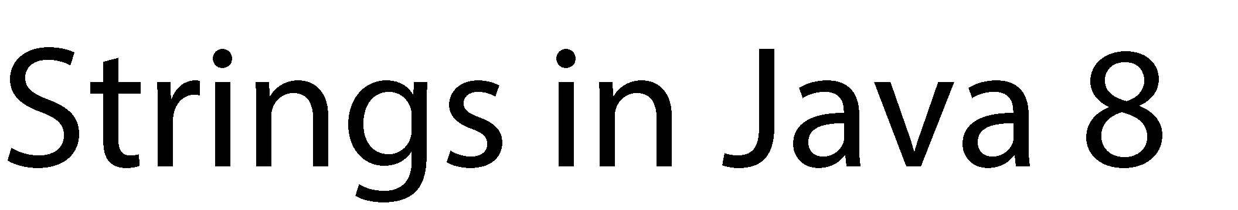

Slide 11






▪
String s = "Hello world!";

Slide 12

▪
String s = "Hello world!";
IntStream stream = s.chars(); // creates a Stream on
// the letters of s

Slide 13




▪
String s = "Hello world!";
IntStream stream = s.chars(); // creates a Stream on
// the letters of s stream.mapToObj(letter -> (char)letter)
.map(Character::toUpperCase)
.forEach(System.out::print);
▪
> HELLO WORLD!

Slide 14






▪
String s1 = "Hello"; String s2 = "world";
String s = s1 + " " + s2; // it works!

Slide 15





















▪
String s1 = "Hello"; String s2 = "world";
String s = s1 + " " + s2; // it works!
▪
▪
▪

Slide 16


▪
StringBuffer sb1 = new StringBuffer(); sb1.append("Hello");

Slide 17
▪
StringBuffer sb1 = new StringBuffer(); sb1.append("Hello");
sb1.append(" ").append("world"); // can be chained

Slide 18
▪
StringBuffer sb1 = new StringBuffer(); sb1.append("Hello");
sb1.append(" ").append("world"); // can be chained String s = sb1.toString();

Slide 19




▪
StringBuffer sb1 = new StringBuffer(); sb1.append("Hello");
sb1.append(" ").append("world"); // can be chained String s = sb1.toString();
▪

Slide 20

▪
// The JDK 5 way
StringBuilder sb1 = new StringBuilder(); sb1.append("Hello");
sb1.append(" ").append("world"); // can be chained String s = sb1.toString();
▪

Slide 21








▪
// The JDK 5 way
StringBuilder sb1 = new StringBuilder(); sb1.append("Hello");
sb1.append(" ").append("world"); // can be chained String s = sb1.toString();
▪
▪

Slide 22










▪
▪
// The JDK 8 way
StringJoiner sj = new StringJoiner(", "); sj.add("one").add("two").add("three");

Slide 23
▪
▪
// The JDK 8 way
StringJoiner sj = new StringJoiner(", "); sj.add("one").add("two").add("three"); String s = sj.toString(); System.out.println(s);
▪
> one, two, three

Slide 24









▪
▪
// The JDK 8 way
StringJoiner sj = new StringJoiner(", ", "{", "}");
// we leave the joiner empty String s = sj.toString(); System.out.println(s);

Slide 25
▪
▪
// The JDK 8 way
StringJoiner sj = new StringJoiner(", ", "{", "}");
// we leave the joiner empty String s = sj.toString(); System.out.println(s);
▪
> {}

Slide 26
▪
▪
// The JDK 8 way
StringJoiner sj = new StringJoiner(", ", "{", "}"); sj.add("one");
String s = sj.toString();
System.out.println(s);
▪
> {one}

Slide 27
▪
▪
// The JDK 8 way
StringJoiner sj = new StringJoiner(", ", "{", "}");
sj.add("one").add("two").add("three"); String s = sj.toString(); System.out.println(s);
▪
> {one, two, three}

Slide 28




▪
// From the String class, with a vararg
String s = String.join(", ", "one", "two", "three"); System.out.println(s);
▪
> one, two, three

Slide 29
▪
// From the String class, with an Iterable String [] tab = {"one", "two", "three"}; String s = String.join(", ", tab); System.out.println(s);
▪
> one, two, three

Slide 30



Slide 31










▪
// Java 7 : try with resources try (BufferedReader reader =
new BufferedReader( new FileReader(
new File("d:/tmp/debug.log")));) {
Stream<String> stream = reader.lines();
stream.filter(line -> line.contains("ERROR"))
.findFirst()
.ifPresent(System.out::println);
} catch (IOException ioe) {
// handle the exception
}

Slide 32





▪
// Java 7 : try with resources and use of Paths Path path = Paths.get("d:", "tmp", "debug.log"); try (Stream<String> stream = Files.lines(path)) {
stream.filter(line -> line.contains("ERROR"))
.findFirst()
.ifPresent(System.out::println);
} catch (IOException ioe) {
// handle the exception
}

Slide 33







▪
// Java 7 : try with resources and use of Paths Path path = Paths.get("d:", "tmp", "debug.log"); try (Stream<String> stream = Files.lines(path)) {
stream.filter(line -> line.contains("ERROR"))
.findFirst()
.ifPresent(System.out::println);
} catch (IOException ioe) {
// handle the exception
}
▪

Slide 34


▪
// Java 7 : try with resources and use of Paths Path path = Paths.get("c:", "windows");
try (Stream<Path> stream = Files.list(path)) {
stream.filter(path -> path.toFile().isDirectory())
.forEach(System.out::println);
} catch (IOException ioe) {
// handle the exception
}

Slide 35




▪
// Java 7 : try with resources and use of Paths Path path = Paths.get("c:", "windows");
try (Stream<Path> stream = Files.list(path)) {
stream.filter(path -> path.toFile().isDirectory())
.forEach(System.out::println);
} catch (IOException ioe) {
// handle the exception
}
▪

Slide 36







▪
// Java 7 : try with resources and use of Paths Path path = Paths.get("c:", "windows");
try (Stream<Path> stream = Files.walk(path)) {
stream.filter(path -> path.toFile().isDirectory())
.forEach(System.out::println);
} catch (IOException ioe) {
// handle the exception
}

Slide 37




▪
// Java 7 : try with resources and use of Paths Path path = Paths.get("c:", "windows");
try (Stream<Path> stream = Files.walk(path, 2)) {
stream.filter(path -> path.toFile().isDirectory())
.forEach(System.out::println);
} catch (IOException ioe) {
// handle the exception
}
▪

Slide 38


Slide 39










▪
▪

Slide 40





▪
// Unfortunately not for arrays
List<String> strings =
Arrays.asList("one", "two", "three");
strings.forEach(System.out::println);

Slide 41



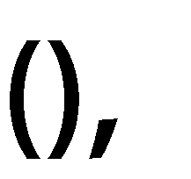


▪
// removes an element on a predicate Collection<String> strings =
Arrays.asList("one", "two", "three", "four");
// will not work if list is unmodifiable Collection<String> list = new ArrayList<>(strings);
// returns true if the list has been modified boolean b = list.removeIf(s -> s.length() > 4);
System.out.println( list.stream().collect(Collectors.joining(", ")));

Slide 42

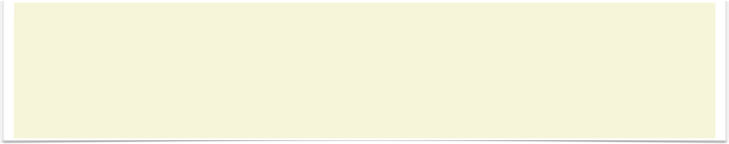
▪
// removes an element on a predicate Collection<String> strings =
Arrays.asList("one", "two", "three", "four");
// will not work if list is unmodifiable Collection<String> list = new ArrayList<>(strings);
// returns true if the list has been modified boolean b = list.removeIf(s -> s.length() > 4);
System.out.println( list.stream().collect(Collectors.joining(", ")));
▪
> one, two, four

Slide 43


▪
// removes an element on a predicate List<String> strings =
Arrays.asList("one", "two", "three", "four");
// will not work if list is unmodifiable List<String> list = new ArrayList<>(strings);
// doesnt return anything list.replaceAll(String::toUpperCase);
System.out.println( list.stream().collect(Collectors.joining(", ")));

Slide 44
▪
// removes an element on a predicate List<String> strings =
Arrays.asList("one", "two", "three", "four");
// will not work if list is unmodifiable List<String> list = new ArrayList<>(strings);
// doesnt return anything list.replaceAll(String::toUpperCase);
System.out.println( list.stream().collect(Collectors.joining(", ")));
▪
> ONE, TWO, THREE, FOUR

Slide 45

▪
// removes an element on a predicate List<String> strings =
Arrays.asList("one", "two", "three", "four");
// will not work if list is unmodifiable List<String> list = new ArrayList<>(strings);
// doesnt return anything list.sort(Comparator.naturalOrder());
System.out.println( list.stream().collect(Collectors.joining(", ")));

Slide 46
▪
// removes an element on a predicate List<String> strings =
Arrays.asList("one", "two", "three", "four");
// will not work if list is unmodifiable List<String> list = new ArrayList<>(strings);
// doesnt return anything list.sort(Comparator.naturalOrder());
System.out.println( list.stream().collect(Collectors.joining(", ")));
▪
> four, one, three, two

Slide 47


Slide 48






▪
// comparison using the last name Comparator<Person> compareLastName =
new Comparator<Person>() {
@Override
public int compare(Person p1, Person p2) {
return p1.getLastName().compareTo(p2.getLastName());
}
};

Slide 49





▪
// comparison using the last name Comparator<Person> compareLastName =
new Comparator<Person>() {
@Override
public int compare(Person p1, Person p2) {
return p1.getLastName().compareTo(p2.getLastName());
}
};
▪

Slide 50


▪
// comparison using the last name then the first name Comparator<Person> compareLastNameThenFirstName =
new Comparator<Person>() {
@Override
public int compare(Person p1, Person p2) { int lastNameComparison =
p1.getLastName().compareTo(p2.getLastName()); return lastNameComparison == 0 ?
p2.getFirstName().compareTo(p2.getFirstName()); lastNameComparison;
}
};
▪

Slide 51

▪
// comparison using the last name Comparator<Person> compareLastName =
Comparator.comparing(Person::getLastName);

Slide 52





▪
// comparison using the last name and then the first name Comparator<Person> compareLastNameThenFirstName =
Comparator.comparing(Person::getLastName)
.thenComparing(Person::getFirstName);
▪

Slide 53




▪
// comparison using the last name Comparator<Person> compareLastName =
Comparator.comparing(Person::getLastName);
▪

Slide 54







▪
// reverses a comparator Comparator<Person> comp = ...;
Comparator<Person> reversedComp = comp.reversed();

Slide 55

▪
// compares comparable objects Comparator<String> c = Comparator.naturalOrder();

Slide 56

▪
// compares comparable objects Comparator<String> c = Comparator.naturalOrder();
▪
// compares comparable objects in the reverse order Comparator<String> c = Comparator.reversedOrder();

Slide 57




▪
// considers null values lesser than non-null values Comparator<String> c =
Comparator.nullsFirst(Comparator.naturalOrder());

Slide 58

▪
// considers null values lesser than non-null values Comparator<String> c =
Comparator.nullsFirst(Comparator.naturalOrder());
▪
// considers null values greater than non-null values Comparator<String> c =
Comparator.nullsLast(Comparator.naturalOrder());

Slide 59


Slide 60











▪
▪

Slide 61















▪
long max = Long.max(1L, 2L);
▪
BinaryOperator<Long> sum = (l1, l2) -> l1 + l2;
= (l1, l2) -> Long.sum(l1, l2);
= Long::sum;

Slide 62

▪
// JDK 7
long l = 3141592653589793238L;
int hash = new Long(l).hashCode(); // -1985256439

Slide 63





▪
// JDK 7
long l = 3141592653589793238L;
int hash = new Long(l).hashCode(); // -1985256439
▪

Slide 64
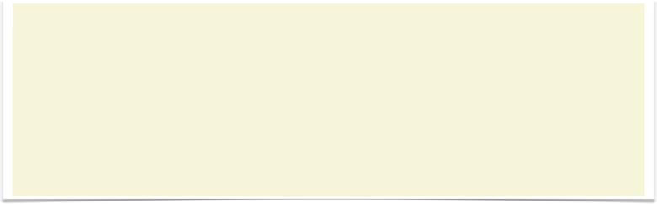




▪
// JDK 7
long l = 3141592653589793238L;
int hash = new Long(l).hashCode(); // -1985256439
▪
// JDK 8
long l = 3141592653589793238L;
int hash = Long.hashCode(l); // - 1985256439
▪

Slide 65


Slide 66





▪
Map<String, Person> map = ...; map.forEach((key, person) ->
System.out.println(key + " " + person);
▪

Slide 67

▪
Map<String, Person> map = ...;
Person p = map.get(key); // p can be null!

Slide 68









▪
Map<String, Person> map = ...;
Person defaultPerson = Person.DEFAULT_PERSON;
Person p = map.getOrDefault(key, defaultPerson); // JDK 8
▪

Slide 69

▪
Map<String, Person> map = ...;
map.put(key, person); // will erase an existing person

Slide 70





▪
Map<String, Person> map = ...;
map.put(key, person);
map.putIfAbsent(key, person); // JDK8
▪

Slide 71



▪
Map<String, Person> map = ...;
map.replace(key, person);
▪

Slide 72




▪
Map<String, Person> map = ...;
map.replace(key, person);
map.replace(key, oldPerson, newPerson);
▪

Slide 73







▪
Map<String, Person> map = ...;
map.replace(key, person);
map.replace(key, oldPerson, newPerson);
map.replaceAll((key, oldPerson) -> newPerson);
▪

Slide 74

▪
Map<String, Person> map = ...; map.remove(key);

Slide 75



▪
Map<String, Person> map = ...; map.remove(key); // JDK 7 map.remove(key, person); // JDK 8
▪

Slide 76
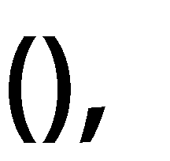

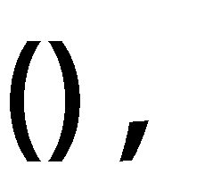


▪
Map<String, Person> map = ...;
map.compute(key, person, (key, oldPerson) -> newPerson);
▪

Slide 77
▪
Map<String, Person> map = ...;
map.computeIfPresent(key, person, (key, oldPerson) -> newPerson);
▪

Slide 78
▪
Map<String, Person> map = ...;
map.computeIfAbsent(key, key -> newPerson);
▪

Slide 79

▪
Map<String, Person> map = ...;
map.computeIfAbsent(key, key -> newPerson);
▪
▪
Map<String, Map<Integer, Person>> bimap = ...;
Person p = ...;
bimap.computeIfAbsent(key1, key -> new HashMap<>()).put(key2, p);

Slide 80









▪
Map<String, Person> map = ...;
map.merge(key, person, (key, person) -> newPerson);
▪

Slide 81


Slide 82














▪
▪
▪
@TestCases({
@TestCase(param=1, expected=false),
@TestCase(param=2, expected=true)
})
public boolean even(int param) { return param % 2 == 0;
}

Slide 83







▪
▪
▪
@TestCases({
@TestCase(param=1, expected=false),
@TestCase(param=2, expected=true)
})
public boolean even(int param) { return param % 2 == 0;
}
▪

Slide 84

▪
▪
▪
@TestCase(param=1, expected=false) @TestCase(param=2, expected=true) public boolean even(int param) {
return param % 2 == 0;
}

Slide 85



▪
▪
▪
@TestCase(param=1, expected=false) @TestCase(param=2, expected=true) public boolean even(int param) {
return param % 2 == 0;
}
▪

Slide 86



▪

Slide 87




▪
▪

Slide 88



▪
▪
▪

Slide 89
▪
▪
▪
@interface TestCase { int param(); boolean expected();
}
@interface TestCases { TestCase[] value();
}

Slide 90







▪
▪
▪
▪
@Repeatable(TestCases.class) @interface TestCase {
int param(); boolean expected();
}
@interface TestCases { TestCase[] value();
}

Slide 91








▪
▪
private @NonNull List<Person> persons = ... ;

Slide 92





▪
▪
private @NonNull List<Person> persons = ... ;
▪
private @NonNull List<@NonNull Person> persons = ... ;

Slide 93
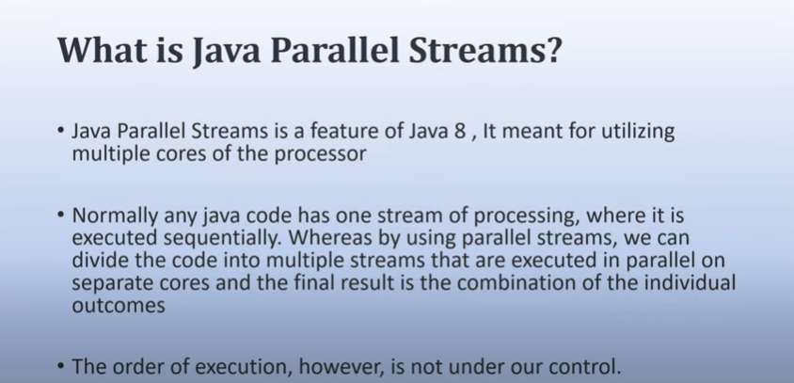

Slide 94
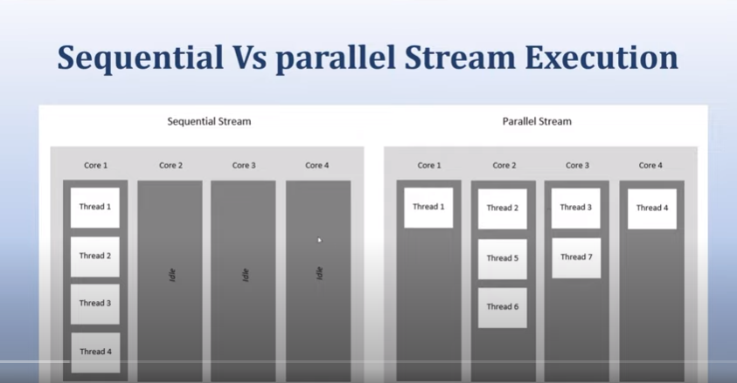

Slide 95
Parallel Streams
Use parallelStream on a collection:
Stream<String> parallelWords = words.parallelStream();
Or use parallel on any stream:
Stream<String> parallelWords = Stream.of(wordArray).parallel();
When the terminal method executes, operations are parallelized.
Intent: Same result as when run sequentially.
Just faster because the work is distributed over available processors.
Example:
long result = wordStream.parallel()
.filter(w -> w.length() > 10)
.count();
The underlying data is partitioned in n regions.
The filtering and counting executes concurrently.
When all counts are ready, they are combined.

Slide 96
Effective Parallelization
Streams from arrays and lists are ordered. Results are predictable, even on parallel streams.
Use findAny instead of findFirst if you don't care about ordering.
Call unordered to speed up limit or distinct:
Stream<String> sample = words.parallelStream().unordered().limit(n);
Use groupingByConcurrent to speed up grouping if you don't care about the order in which the values are processed:
Map<Integer, Long> wordCounts = words.parallelStream()
.collect(
Collectors.groupingByConcurrent( String::length, Collectors.counting()));

Slide 97
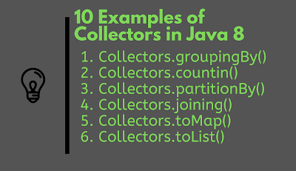
Grouping and Partitioning

Slide 98
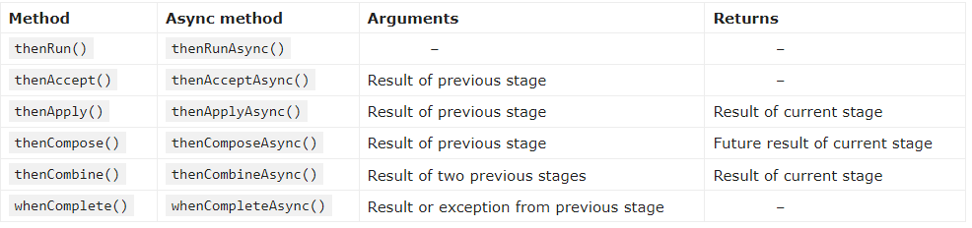
Completable Future

Slide 99
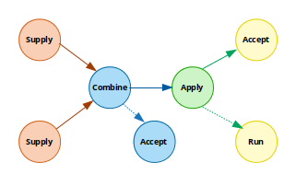
Completable Future

Slide 100

Demo
1. Creating a Completed CompletableFuture
2. Running a Simple Asynchronous Stage
3. Applying a Function on the Previous Stage
4. Asynchronously Applying a Function on a Previous Stage
5. Asynchronously Applying a Function on a Previous Stage Using a Custom Executor
6. Consuming the Result of the Previous Stage
7. Asynchronously Consuming the Result of the Previous Stage
8. Completing a Computation Exceptionally
9. Canceling a Computation
11. Consuming the Result of Either of Two Completed Stages

Slide 101
Demo
Real Life Example

Slide 102
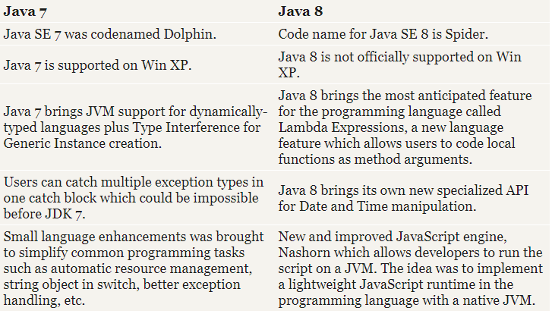
Difference between Java 7 and Java 8

Slide 103



















▪
▪
▪
▪
▪
▪
▪
▪

